Slide 1

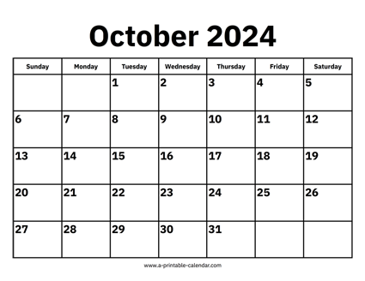

CS 310 : Scalable Software Architectures
Week 05 (Oct 21 – 25)
This week in CS 310:
Focus this week:
Scalability, performance, serverless
Project 02 has been released, two steps:
Program web service for PhotoApp, rewrite client
Configure AWS EC2 to host web service
Both parts due Friday October 25th @ 11:59pm
Exam on Tuesday, October 29th in class
In-person, hand-written
Multiple choice, short answer, code read / write
Some optional readings on JavaScript coding:
https://bit.ly/async-js-intro-01
https://bit.ly/async-js-intro-02

Slide 2
Topics
Review: node.js execution model
Scalability
Horizontal vs. vertical scaling
Performance: latency, bandwidth, throughput
Measuring performance with apache benchmark
Introduction to serverless computing

Slide 3
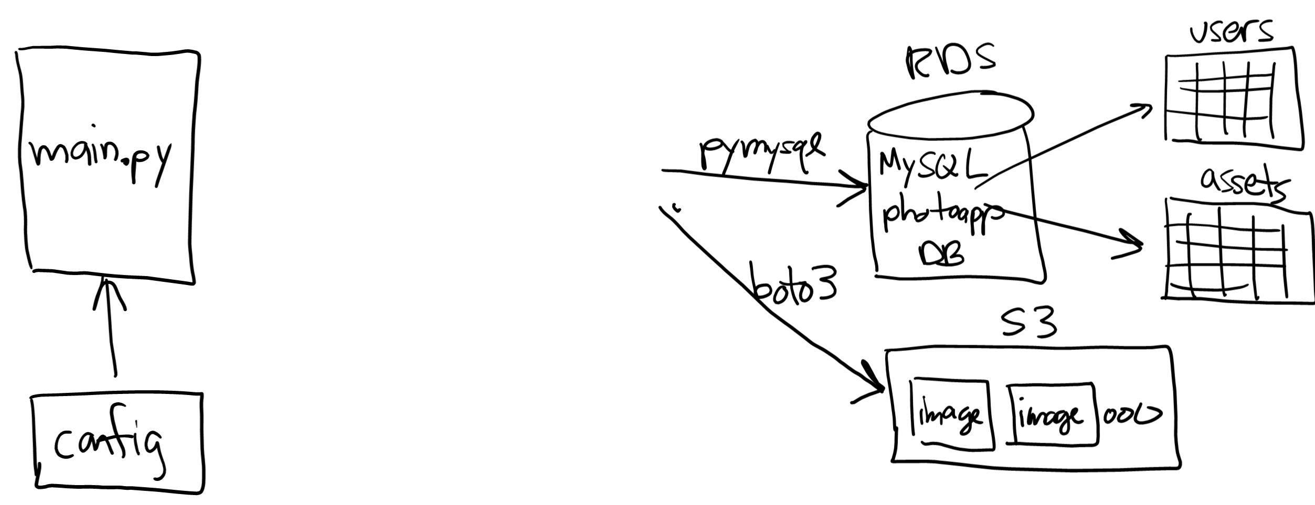






Project 02

Slide 4
Class sessions
Tuesday:
Abstract server-side design scenarios --- "how would you execute these N operations concurrently, given this set of restrictions on the order of operations"
GET vs. PUT/POST requests, testing with postman.com vs. python-based client
Thursday:
Sample exam questions
Q&A: lecture recordings, project 02?

